Slide 1

Differentiation of Complex Functions
EE2007 – Engineering Mathematics II

Slide 2
Differentiation of Complex Functions > Learning Objectives
At the end of this lesson, you should be able to:
Describe the concept of limit and continuity of complex functions.
Explain the differentiability and analyticity of complex functions.

Slide 3
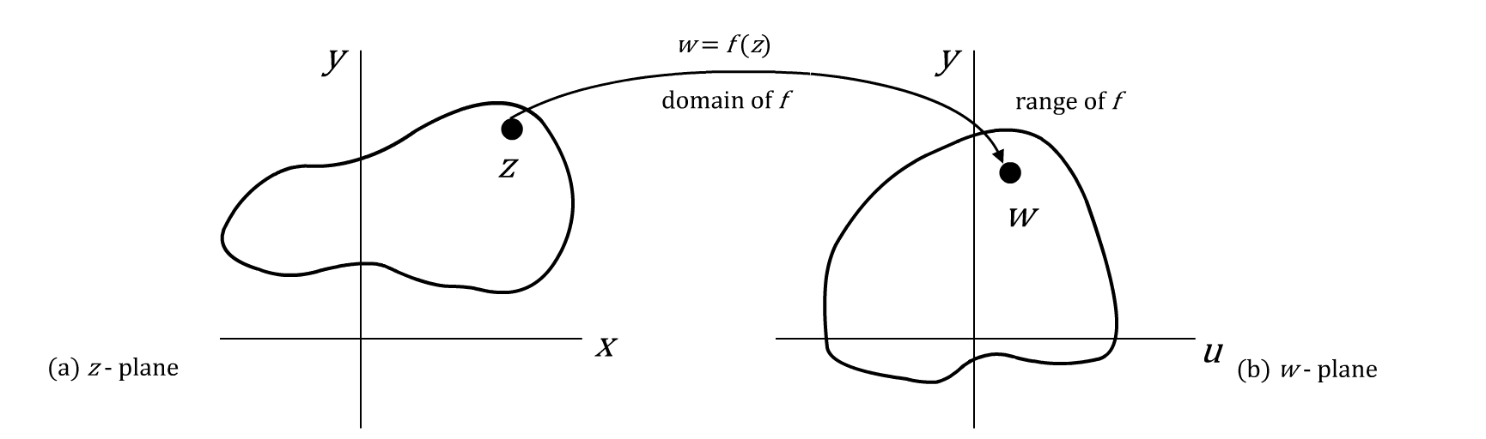
Differentiation of Complex Functions > Complex Functions
A complex function $f$ is concerned with complex functions that are differentiable in some domain.

Slide 4


Differentiation of Complex Functions > Complex Functions
A complex function $f$ is a rule (or mapping) that assigns to every complex number $z$ in a set $S$, and a complex number $w$ in a set $T$.
Mathematically, it can be expressed as $w=f(z)$.
The set $S$ is called the domain of $f$ and the set $T$ is called the range of $f$.
If $z=x+iy$and $w=u+iv$, then,
$$w=f\left(z\right)=u\left(x, y\right)+iv(x, y)$$

Slide 5




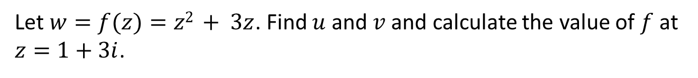
Differentiation of Complex Functions > Complex Functions
Let us take a look at a sample problem to understand the concept of complex functions.
Sample Problem 1
Let $w=f(z)=z2 + 3z$. Find $u$ and $v$ and calculate the value of $f$ at $z=1+3i$.
Solution:
Let $z=x+iy$.
Then, $w=z2+3z$
$$=(x+iy)2+3(x+iy)$$
$$=x2−y2+i2xy+3x+i3y$$

Slide 6




Differentiation of Complex Functions > Complex Functions
Let us take a look at a sample problem to understand the concept of complex functions.
Solution (contd.):
Hence,
$$u=Re\left(w\right)=x2−y2+3x$$
$$v =Im(w)=2xy+3y$$
If,
$$z=x+iy =1+i3$$
then,
$$f(z)=u\left(1, 3\right)+v\left(1, 3\right)=−5+i15$$
Try using the polar form, $z = rθ$, and check if you get the same answer.

Slide 7
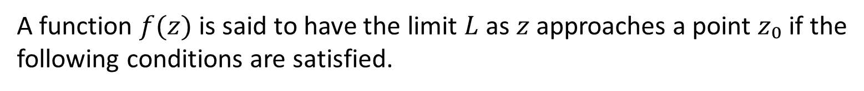
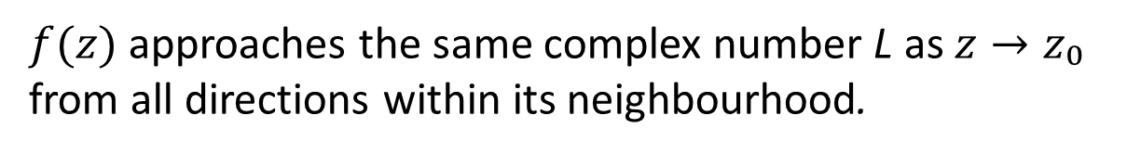
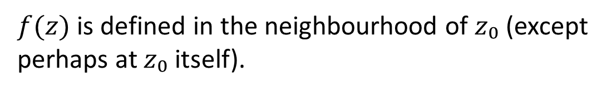
Differentiation of Complex Functions > Limit
A function $f(z)$ is said to have the limit $L$ as $z$ approaches a point $z₀$ if the following conditions are satisfied.
01
$f(z)$ is defined in the neighbourhood of $z₀$ (except perhaps at $z₀$ itself).
02
$f(z)$approaches the same complex number L as $z→z₀$ from all directions within its neighbourhood.

Slide 8
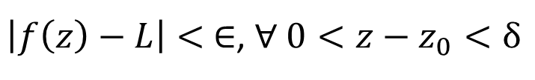

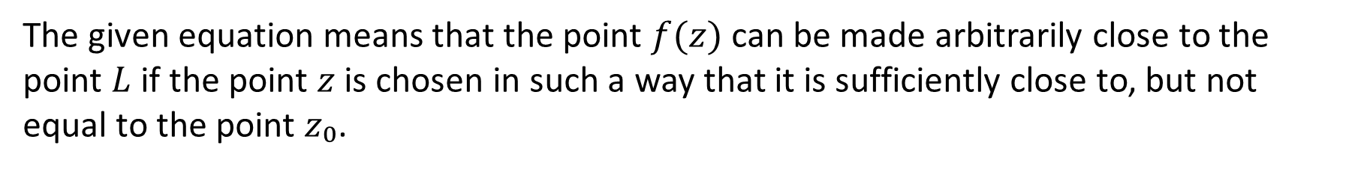

Differentiation of Complex Functions > Limit
Mathematically, the limit of a function $f(z)$ can be expressed as:
$$\lim_{z→z_{0}}{f\left(z\right)}=L$$
If given ∈, there exists $δ>0$, such that,
$\left|f\left(z\right)−L\right|< ∈$, ∀ $0<z−z_{0}<δ$
The given equation means that the point $f(z)$ can be made arbitrarily close to the point $L$ if the point $z$ is chosen in such a way that it is sufficiently close to, but not equal to the point $z₀$.

Slide 9
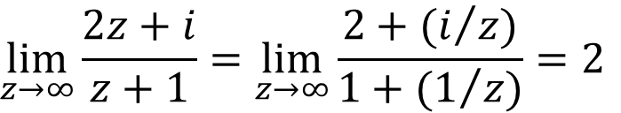
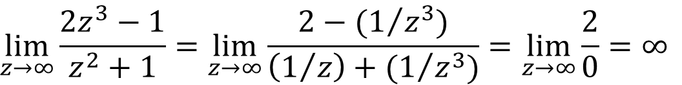
Differentiation of Complex Functions > Limit
Examples
1
$$\lim_{z→∞}{\frac{2z+i}{z+1}}=\lim_{z→∞}{\frac{2+(i/z)}{1+(1/z)}}=2$$
$$\lim_{z→∞}{\frac{2z^{3}−1}{z^{2}+1}}=\lim_{z→∞}{\frac{2−(1/{z^{3}})}{\left(1/z\right)+(1/{z^{3}})}}=\lim_{z→∞}{\frac{2}{0}}=∞$$
2

Slide 10
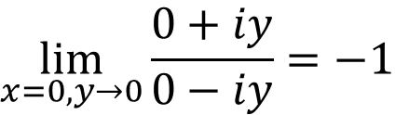
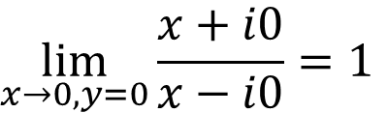
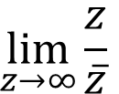
Differentiation of Complex Functions > Limit
Examples (contd.)
3
$$\lim_{z→∞}{\frac{z}{\overline{z}}}$$
does not exist.
Let $y→0$ first and then, let $x→0$. In this case,
$$\lim_{x→0, y=0}{\frac{x+i0}{x−i0}}=1$$
Now, let $x→0$ first and then, let $y→0$. In this case,
$$\lim_{x=0, y→0}{\frac{0+iy}{0−iy}}=−1$$
As the function does not approach the same value from all directions within its neighbourhood, the limit does not exist.

Slide 11
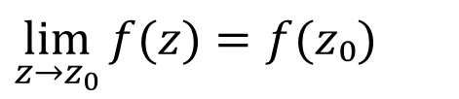
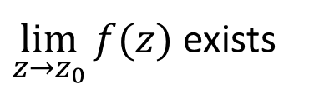
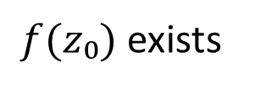
Differentiation of Complex Functions > Continuity
A function $f(z)$is said to be continuous at $z=z₀$if it satisfies the following three conditions.
01
$f(z₀)$exists
Note that if condition (3) is true, it implies that conditions (1) and (2) are true as well.
02
$\lim_{z→z_{0}}{f(z)}$ exists
03
$$\lim_{z→z_{0}}{f(z)}=f(z₀)$$
$f$ is said to be a continuous function, if $f$ is continuous for all $z$ in the domain $S$.

Slide 12
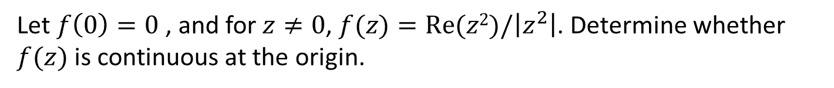
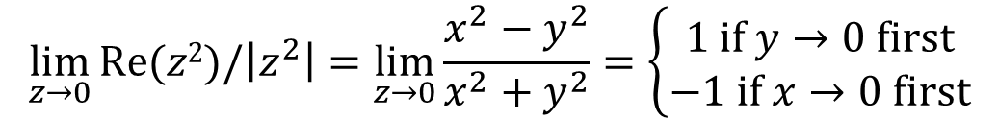

Differentiation of Complex Functions > Continuity
Let us see how to test the continuity of a function with the help of the following sample problem.
Sample Problem 2
Let $f\left(0\right)=0$, and for $z≠0$, $f(z)=Re(z2)/\left|z^{2}\right|$. Determine whether $f(z)$ is continuous at the origin.
Solution:
$$\lim_{z→0}{Re(z2)/\left|z^{2}\right|}=\lim_{z→0}{\frac{x^{2}−y^{2}}{x^{2}+y^{2}}}=\left\{\begin{aligned}1 if y→0 first \\ −1 if x→0 first\end{aligned}\right.$$
Hence, $f$ is not continuous at the origin.

Slide 13
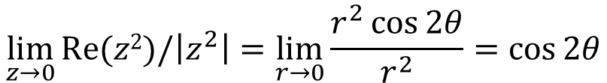

Differentiation of Complex Functions > Continuity
Let us see how to test the continuity of a function with the help of the following sample problem.
Solution (contd.):
Alternatively, using polar representation,
$$z={re}^{iθ}$$
$$=r cos θ+ir\sin{θ}$$
$$\lim_{z→0}{Re(z2)/\left|z^{2}\right|}=\lim_{r→0}{\frac{r^{2}\cos{2θ}}{r^{2}}}=\cos{2θ}$$
The limit does not exist because it depends on the direction of approach to the origin.

Slide 14
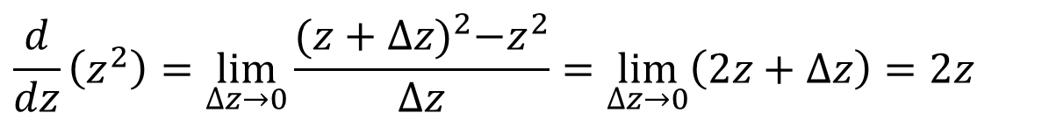
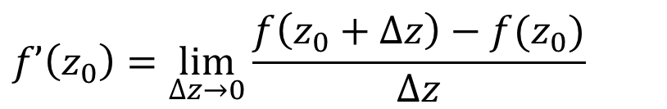


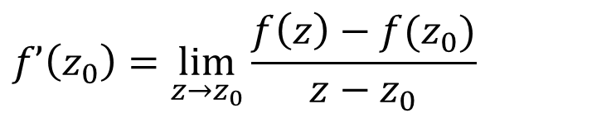
Differentiation of Complex Functions > Derivatives of Complex Functions
The derivative of a complex function $f$ at a point $z₀$ is written as $f’(z₀)$and is defined as:
$$f’\left(z_{0}\right)=\lim_{z→z_{0}}{\frac{f\left(z\right)−f(z_{0})}{z−z_{0}}}$$
, provided that the limit exists.
Or, by substituting $z=z₀+Δz$
$$f’\left(z_{0}\right)=\lim_{∆z→0}\frac{f\left(z_{0}+∆z\right)−f(z_{0})}{∆z}$$
For example,
$$\frac{d}{dz}\left(z^{2}\right)=\lim_{∆z→0}{\frac{{(z+∆z)}^{2}−z^{2}}{∆z}}=\lim_{∆z→0}\left(2z+∆z\right)=2z$$
Thus, $f(z)=z2$is differentiable for all $z$.

Slide 15

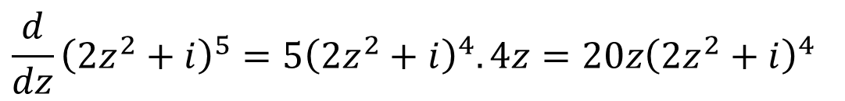
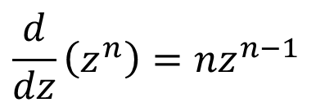

Differentiation of Complex Functions > Derivatives of Complex Functions
The usual differentiation formulae (as in the case of real variables) hold for complex functions. Let us refer to an example.
01
$$\frac{d}{dz}\left(c\right)=0$$
02
$$\frac{d}{dz}\left(z\right)=1$$
03
$$\frac{d}{dz}\left(z^{n}\right)=nz^{n−1}$$
04
$$\frac{d}{dz}{\left(2z^{2}+i\right)}^{5}=5{\left(2z^{2}+i\right)}^{4}.4z=20z{\left(2z^{2}+i\right)}^{4}$$
However, care is required for more unusual functions.

Slide 16


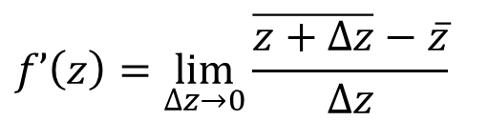


Differentiation of Complex Functions > Derivatives of Complex Functions
Let us take a look at a sample problem to understand the concept of differentiability of complex functions.
Sample Problem 3
Discuss the differentiability of $\overline{z}$.
Solution:
Let $f(z)=\overline{z}$
$$f’\left(z\right)=\lim_{∆z→0}{\frac{\overline{z+∆z}−\overline{z}}{∆z}}$$
Using the property $\overline{z+∆z}=\overline{z}+\overline{∆z}$
$$f’\left(z\right)=\lim_{∆z→0}{\frac{\overline{∆z}}{∆z}}$$

Slide 17
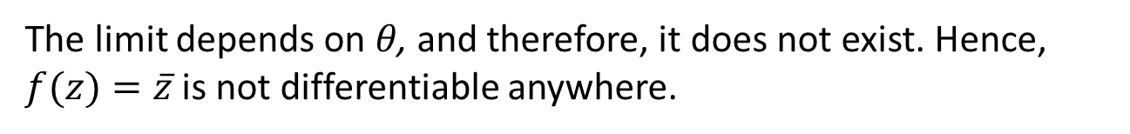
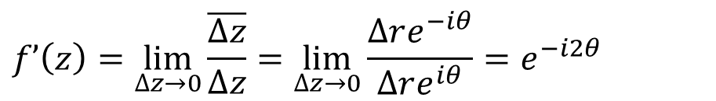
Differentiation of Complex Functions > Derivatives of Complex Functions
Let us take a look at a sample problem to understand the concept of differentiability of complex functions.
Solution (contd.):
Now, consider $Δz=Δreiθ$. Then, $Δz→0$ from all directions when $Δr→0$.
Thus, the limit can be determined as follows:
$$f’\left(z\right)=\lim_{∆z→0}{\frac{\overline{∆z}}{∆z}}=\lim_{∆z→0}{\frac{∆re^{−iθ}}{∆re^{iθ}}}=e^{−i2θ}$$
The limit depends on 𝜃, and therefore, it does not exist. Hence, $f(z)=\overline{z}$ is not differentiable anywhere.

Slide 18
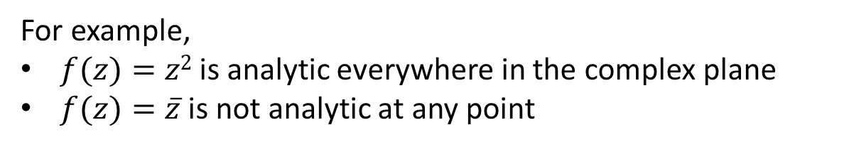


Differentiation of Complex Functions > Analytic Functions
A function $f(z)$is said to be analytic at a point $z₀$if its derivative exists not only at $z₀$, but also in some neighbourhood of $z₀$.
A function $f(z)$ is said to be analytic in the domain $D$ if it is analytic at each point in $D$.
Hence, analyticity implies differentiability and continuity.
The point $z=z₀$, where $f(z)$ceases to be analytic. It is called the singular point or singularity of $f(z)$.
For example,
$f(z)=z2$is analytic everywhere in the complex plane
$f(z)=\overline{z}$is not analytic at any point

Slide 19

Differentiation of Complex Functions > Cauchy-Riemann Equations
Cauchy-Riemann (C-R) Equations can be used to test the analyticity of a complex function.
Theorem 1: The complex function $f(z)=u(x,y)+iv(x,y)$is analytic at a point $z₀$ if for every point in the neighbourhood of $z₀$.
1
$u$, $v$, and their partial derivatives exist and are continuous.
2
Cauchy-Riemann equations, $u_{x}=v_{y}$ and$v_{x}={−u}_{y}$ are satisfied.
If these two conditions are satisfied in some domain $D$, then the function is analytic in $D$.

Slide 20
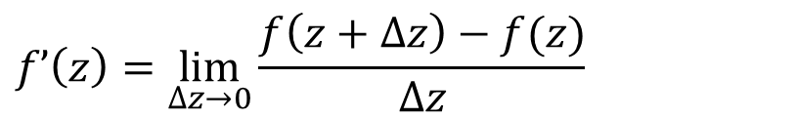

Differentiation of Complex Functions > Cauchy-Riemann Equations
Derivation of the C-R Equations
The derivative of a complex function $f$ at a point $z₀$ is given by:
$$f’\left(z\right)=\lim_{∆z→0}\frac{f\left(z+∆z\right)−f(z)}{∆z}$$
$$=\lim_{∆x, ∆y→0}\frac{u\left(x+∆x, y+∆y\right)+iv\left(x+∆x, y+∆y\right)−u\left(x,y\right)−iv(x,y)}{∆x+i∆y}$$
Along the $x$-axis, that is, $Δy=0$,
$$f’\left(z\right)=\lim_{∆x→0}\frac{u\left(x+∆x, y\right)+iv\left(x+∆x, y\right)−u\left(x,y\right)−iv(x,y)}{∆x}$$
$$=\lim_{∆x→0}\frac{u\left(x+∆x, y\right)−u(x,y)+i(v\left(x+∆x, y\right)−v\left(x,y\right))}{∆x}=\frac{∂u}{∂x}+i\frac{∂v}{∂x}$$

Slide 21

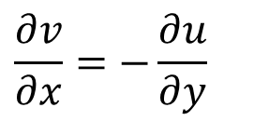
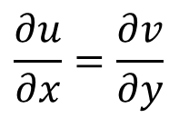
Differentiation of Complex Functions > Cauchy-Riemann Equations
Derivation of the C-R Equations
Similarly, along the $y$-axis, that is, $Δx=0$,
$$f’\left(z\right)=\lim_{∆y→0}\frac{u\left(x, y+∆y\right)+iv\left(x, y+∆y\right)−u\left(x,y\right)−iv(x,y)}{i∆y}$$
$$=\lim_{∆y→0}\frac{u\left(x, y+∆y\right)−u\left(x,y\right)+i(v\left(x, y+∆y\right)−v\left(x,y\right))}{i∆y}=−i\frac{∂u}{∂y}+\frac{∂v}{∂y}$$
For the derivative to exist, the two limits must agree, that is:
$$\frac{∂u}{∂x}=\frac{∂v}{∂y}$$
$$\frac{∂v}{∂x}=−\frac{∂u}{∂y}$$
and

Slide 22
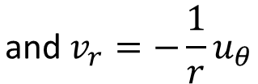


Differentiation of Complex Functions > Cauchy-Riemann Equations
Derivation of the C-R Equations
Thus, the C-R equations are:
$u_{x}=v_{y}$ and $v_{x}=−u_{y}$
When $z≠0$, the C-R equations in polar coordinates are:
$$u_{r}=\frac{1}{r}v_{θ}$$
$$\text{and} v_{r}=−\frac{1}{r}u_{θ}$$

Slide 23



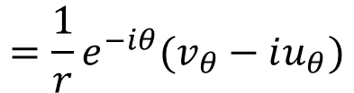


Differentiation of Complex Functions > Cauchy-Riemann Equations
Derivatives of Complex functions
If $f(z)=u(x,y)+iv(x,y)$ and $f’(z)$exists, then,
$$f’(z)=u_{x}+iv_{x}$$
$$=v_{y}−iu_{y}$$
$$=u_{x}−iu_{y}$$
$$=v_{y}+iv_{x}$$
In polar form, if $f(z)=u(r,θ)+iv (r,θ)$and $f’(z)$exists, then,
$$f’(z)=e^{−iθ}(u_{r}+iv_{r})$$
$$={\frac{1}{r}e}^{−iθ}(v_{θ}−iu_{θ})$$

Slide 24




Differentiation of Complex Functions > Cauchy-Riemann Equations
The following sample problem demonstrates how Cauchy-Riemann equations are used to test the analyticity of a complex function.
Sample Problem 4
Verify that $f\left(z\right)=\overline{z}$ is not analytic.
Solution:
Using C-R equations,
$u\left(x,y\right)=x$ and $v\left(x,y\right)=−y$
Now, $uy=−vx = 0$
However, $ux=1$ and $vy=−1$
As the C-R equations are not satisfied, the given function is not analytic.

Slide 25
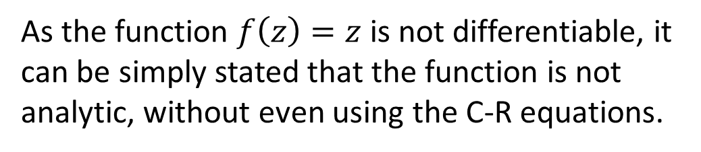
Differentiation of Complex Functions > Cauchy-Riemann Equations
The following sample problem demonstrates how Cauchy-Riemann equations are used to test the analyticity of a complex function.
Sample Problem 4
Verify that $f\left(z\right)=\overline{z}$ is not analytic.
Solution
As the function $f\left(z\right)=z$is not differentiable, it can be simply stated that the function is not analytic, without even using the C-R equations.
Using C-R equations,
$u\left(x,y\right)=x$ and $v\left(x,y\right)=−y$
Now, $uy=−vx = 0$
However, $ux=1$ and $vy=−1$
As the C-R equations are not satisfied, the given function is not analytic.

Slide 26



Differentiation of Complex Functions > Cauchy-Riemann Equations
The following sample problem demonstrates how Cauchy-Riemann equations are used to test the analyticity of a complex function.
Sample Problem 5
Is $f(z)=z3$analytic?
Solution:
In general, polynomials of complex variables are analytic. Let’s solve the given problem using C-R equations.
$$f(z)=z3$$
$u(r,θ)=r3cos3θ$ and $v(r,θ)=r3sin3θ$

Slide 27
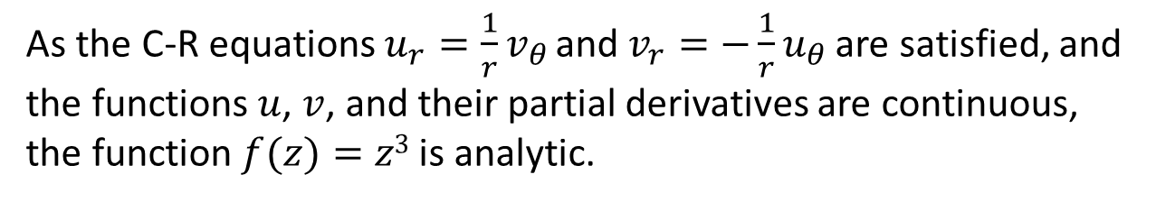

Differentiation of Complex Functions > Cauchy-Riemann Equations
The following sample problem demonstrates how Cauchy-Riemann equations are used to test the analyticity of a complex function.
Solution (contd.):
Therefore, $u_{r}=3r2cos3θ$ and $u_{θ}=−3r3sin3θ$
$v_{r}=3r2sin3θ$ and $v_{θ}=3r3cos3θ$
As the C-R equations $u_{r}=\frac{1}{r}v_{θ}$ and $v_{r}=−\frac{1}{r}u_{θ}$ are satisfied, and the functions $u$, $v$, and their partial derivatives are continuous, the function $f(z)=z3$is analytic.

Slide 28

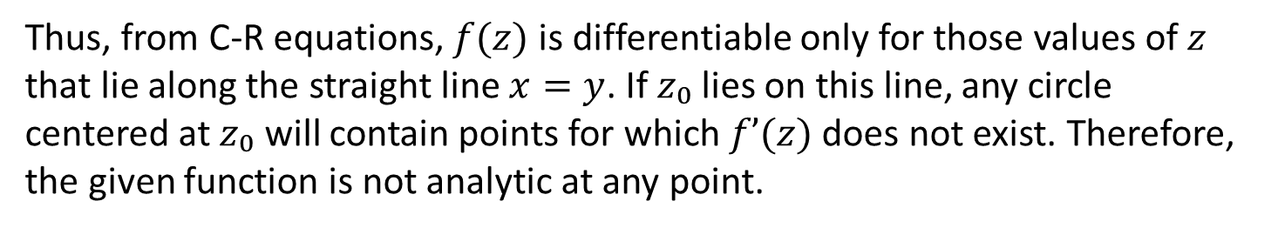
Differentiation of Complex Functions > Cauchy-Riemann Equations
Here is another sample problem that helps us understand how these equations are used to test the analyticity of a complex function.
Sample Problem 6
Discuss the analyticity of the function $f(z)=x2+iy2$.
Solution:
With $u=x2$and $v=y2$: $u_{x}=2x$ and $v_{y}=2y$
$v_{x}=0$ and $u_{y}=0$
Thus, from C-R equations, $f(z)$ is differentiable only for those values of $z$ that lie along the straight line $x=y$. If $z₀$lies on this line, any circle centered at $z₀$ will contain points for which $f’(z)$ does not exist. Therefore, the given function is not analytic at any point.

Slide 29




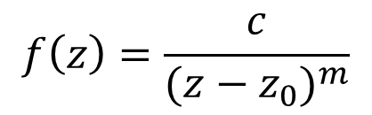
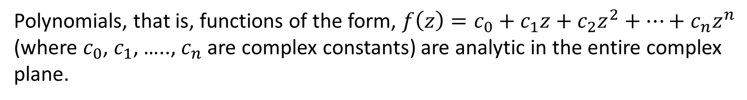
Differentiation of Complex Functions > Cauchy-Riemann Equations
Some Common (and Important) Functions
Polynomials, that is, functions of the form, $f\left(z\right)=c_{0}+c_{1}z+c_{2}z^{2}+…+c_{n}z^{n}$ (where $c_{0}$, $c_{1}$, ….., $c_{n}$ are complex constants) are analytic in the entire complex plane.
$$f\left(z\right)=\frac{g(z)}{h(z)}$$
Rational functions, that is, quotient of two polynomials,
are analytic except at points where $h(z)=0$.
Partial fractions of the form
$$f\left(z\right)=\frac{c}{{(z−z_{0})}^{m}}$$
, where $c$ and $z_{0}$ are complex,
and $m$ is a positive integer, are analytic except at $z_{0}$.

Slide 30
Summary

Slide 31



Differentiation of Complex Functions > Summary
Key points discussed in this lesson:
A complex function $f$ is a rule (or mapping) that assigns to every complex number $z$ in a set $S$, and a complex number $w$ in a set $T$.
A function $f(z)$is said to have the limit $L$ as $z$ approaches a point $z₀$if:
$f(z)$ is defined in the neighbourhood of $z₀$(except perhaps at $z₀$ itself)
$f(z)$approaches the same complex number $L$ as $z→z₀$from all directions within its neighbourhood
A function $f(z)$is said to be continuous at $z=z₀$ if:
$f(z₀)$ exists
$\lim_{z→z_{0}}{f(z)}$ exists
$\lim_{z→z_{0}}{f(z)}=f(z_{0})$ exists

Slide 32
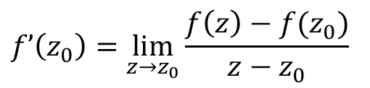
Differentiation of Complex Functions > Summary
Key points discussed in this lesson:
The derivative of a complex function $f$ at a point $z₀$ is written as $f’(z₀)$and is defined as:
$$f’\left(z_{0}\right)=\lim_{z→z_{0}}\frac{f\left(z\right)−f(z_{0})}{z−z_{0}}$$
, provided that the limit exists.
A function $f(z)$ is said to be analytic at a point $z₀$ if its derivative exists not only at $z₀$, but also in some neighbourhood of $z₀$.

